Slide 1
Virtual Labs 3.0
Senior Project – Summer 2015
Crystal Rivera – Scrum Master

Slide 2
PROBLEM Definition
The current system provides an interface in eFront , which integrates with Moodle, that allows students to reserve different types of resources which include virtual labs, mentoring and certificate exams. The system also utilizes a combination of Vmware, KVM, and Java applets to host the RDP sessions for the labs.
Current Limitations
Utilizing Moodle is unnecessary since the eFront LMS can handle the modular functionality we need.
Java applets are becoming outdated and are being phased out of most major browsers.
Rather than using both KVM and Vmware, it was decided for uniformity to convert to just KVM

Slide 3
Project Management

Slide 4
Requirements
implemented use cases

Slide 5
Virtual Labs – implemented stories
Major Feature Stories:
Story 201/232 – Migrate Moodle vLabs into eFront & Finalize vLabs Module
Story 153 -- Create REST Calls with Parameters for User RDP Sessions
Story 137 – Create module themes consistent with eFront
Story 188/190 – Create control navbar in vLabs & Implement navbar functionality
*User interface customization was an ongoing process across all stories assigned.
Other Stories Completed:
Story 138 – Resize module according to browser window
Story 213 – Replace scripts in vLabs Module with their equivalent online versions
Story 225 – Fix the cookie for the encrypted password in eFront
Story 173 – Create vLabsAdmin module
Story 167 – Grant/Deny vLabs access to user type through vLabsAdmin
Story 171 – Present jQuery to the team

Slide 6
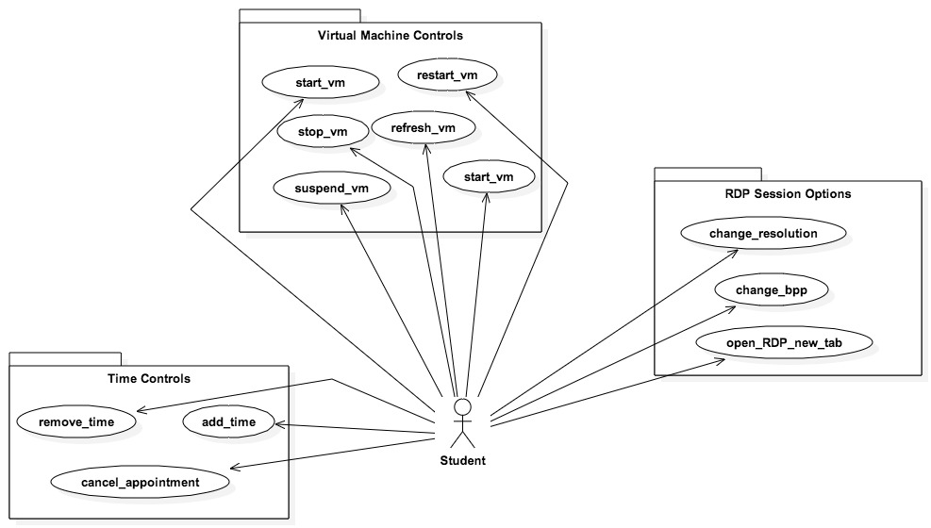
Use Case Diagram

Slide 7
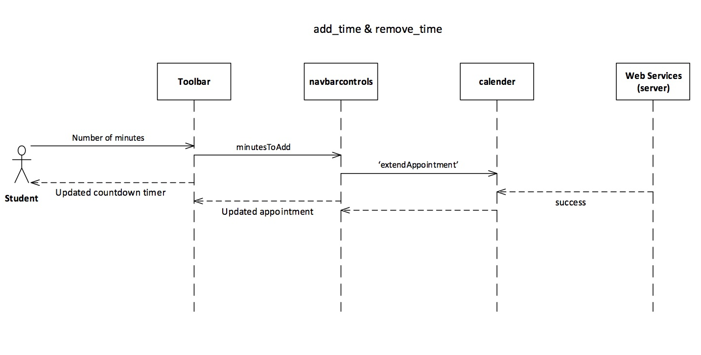
Sequence Diagrams – time controls

Slide 8
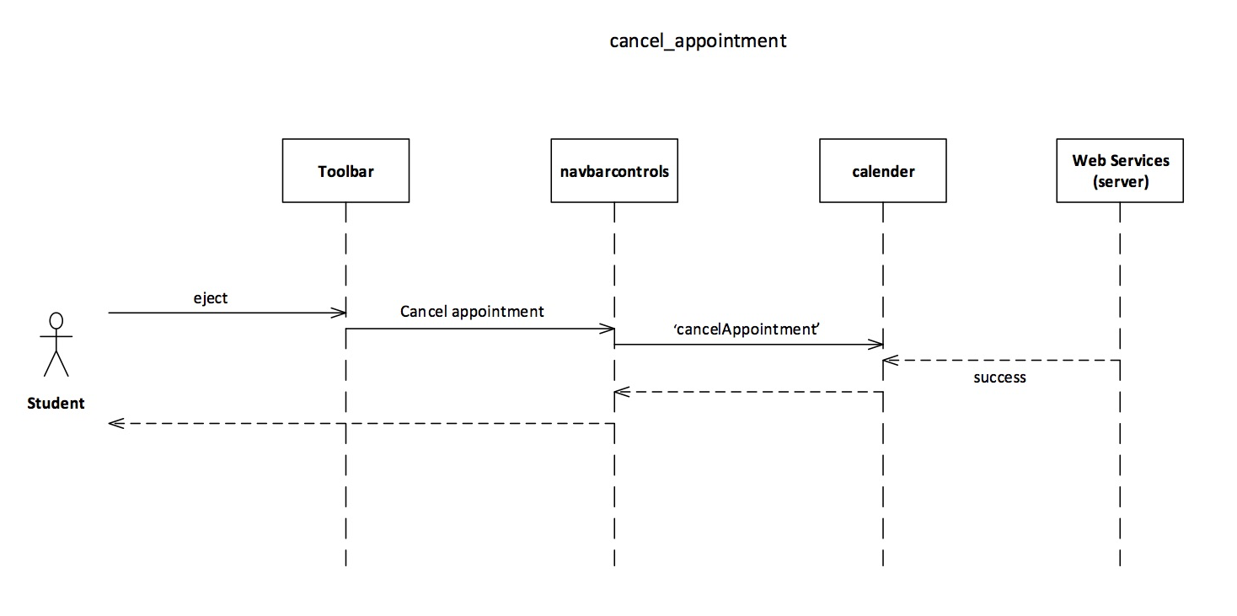
Sequence Diagrams – time controls

Slide 9
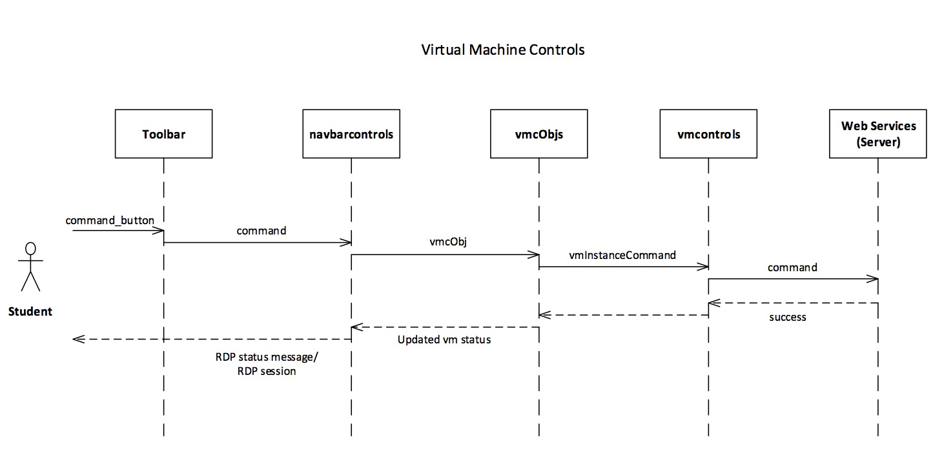
Sequence Diagrams – VM controls

Slide 10
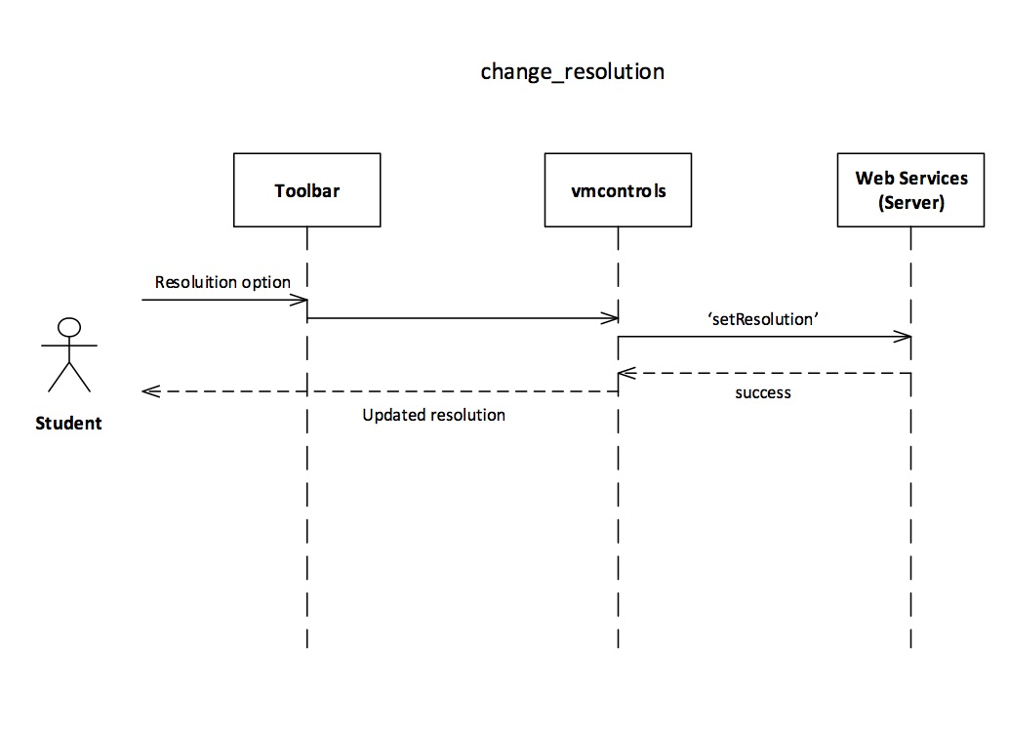
Sequence Diagrams – RDP session options

Slide 11
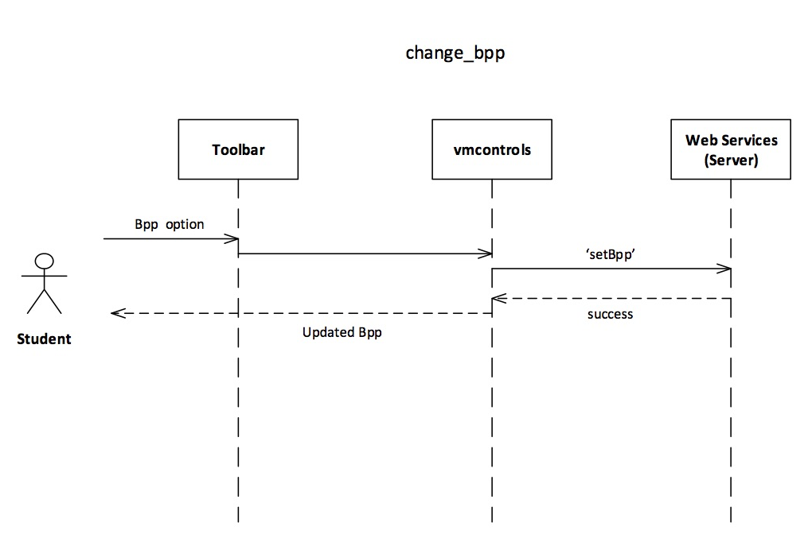
Sequence Diagrams – RDP session options

Slide 12
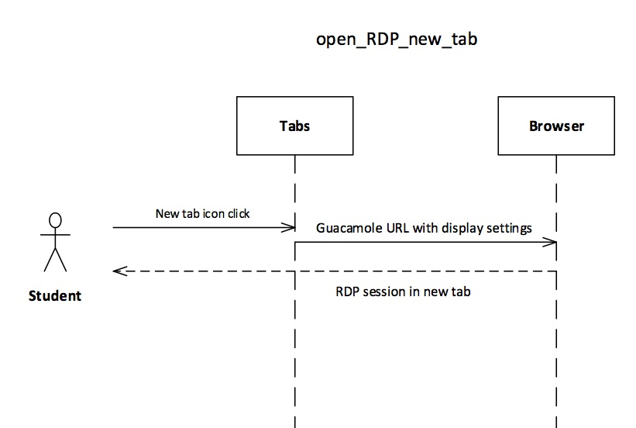
Sequence Diagrams – RDP session options

Slide 13
System design
Design & deployment

Slide 14
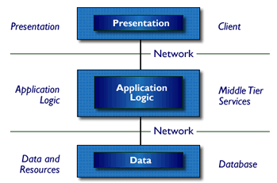
Virtual Labs - System Decomposition
The Virtual Labs system utilizes a 3-tier architectural design

Slide 15
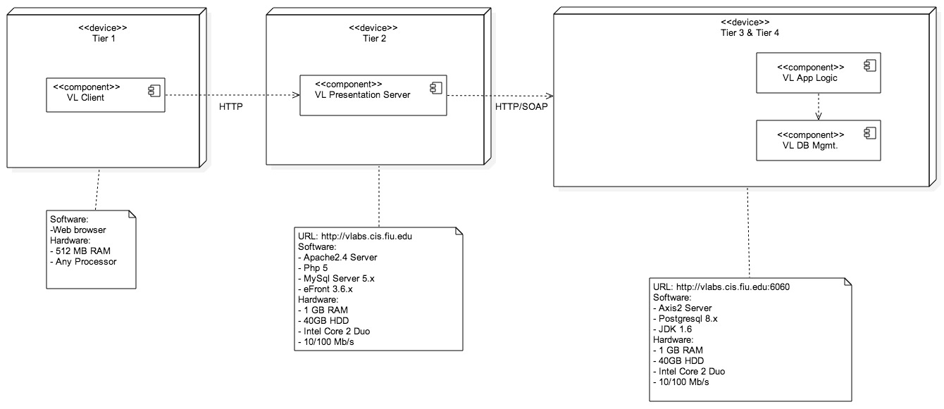
Virtual Labs – System Deployment

Slide 16
Persistent Data design
Virtual Labs maintains a schedule object for each student. This object consists of:
veInsSchId: a unique id to identify the schedule object
curDate: the current date
endDate: the end date for the appointment
reason: status message
resourceType: “VIRTUAL_LAB” – specificies the appointment type
success: status boolean
In addition to this object, we also maintain an Instance Info object that holds the virtual environment information:
kserver: this virtual environment’s Kaseya Server instance and its connection info
vminfo: this virtual environment’s virtual machine instances and their connection info
reason: status message
success: status boolean

Slide 17
Security & Privacy
There is a predefined set of user types that dictates which are granted vLabs access and which are not. If the user type is not in this list, it defaults to false (i.e. no access)
Each user’s virtual lab is scheduled with a unique veInsSchId that is used to load the appropriate virtual labs instance in combination with user credentials.
No user can access a virtual lab instance that is not their own.
Similarly, each virtual machine for the virtual environment has its own unique vmInsSchId to identify the individual machines.
This ensures isolation of the workspace

Slide 18
Detailed design
Class & object

Slide 19
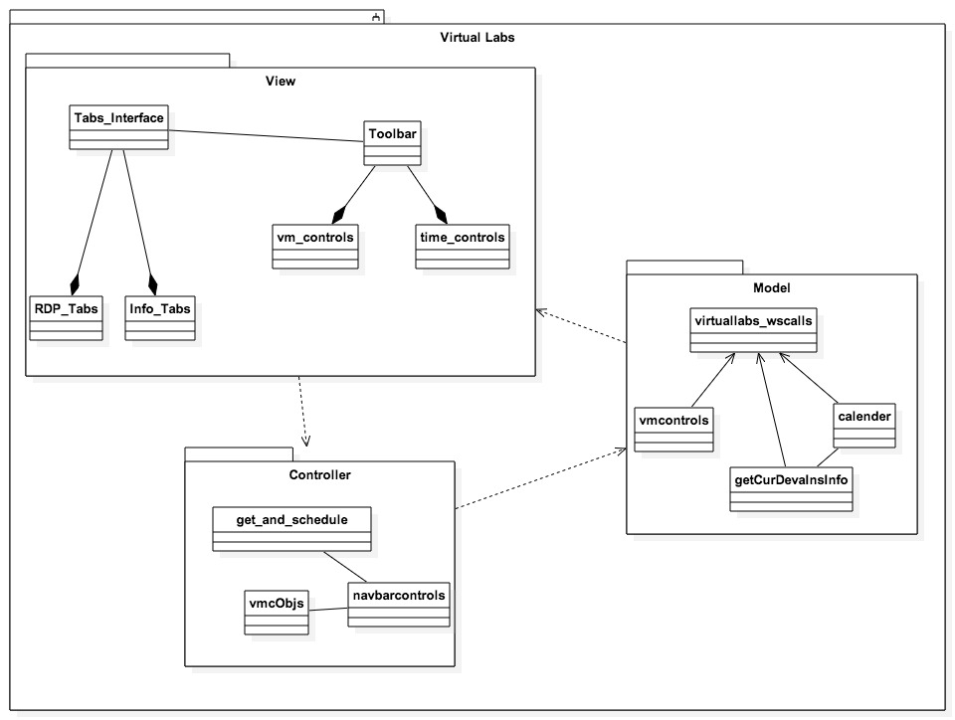
Class Diagram

Slide 20
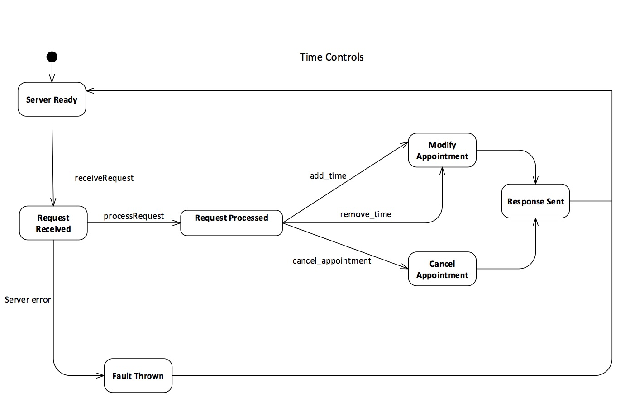
State Diagram

Slide 21
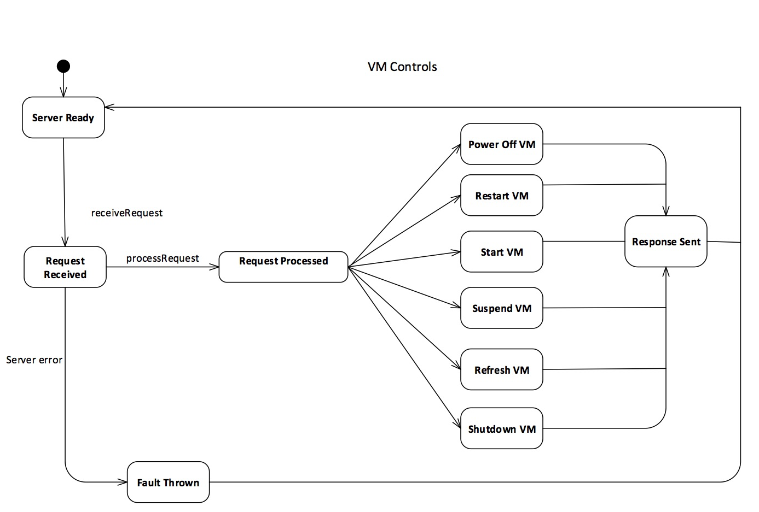
State Diagram

Slide 22
Time Controls Algorithm
The algorithm implemented for altering an appointment is as follows:
If add or remove, grab number of minutes from input field.
Along with user credentials and veInsSchId, the request is sent to the scheduler and the appointment is updated accordingly.
If cancel appointment,
The user credentials and veInsSchId are sent to calendar and the appointment is cancelled and the user is redirected away from virtual labs.

Slide 23
VM Controls Algorithm
The algorithm implemented for controlling a VM is as follows:
The command is grabbed from the clicked button.
A vmcObj is built around this command along with the veInsSchId and the virtual machine name
Then an AJAX call is used with the objects information along with user credentials
The receiver then interacts with web services to send the appropriate command to the virtual machine.
The calls return, with the user interface displaying a status message and the virtual machine’s status updated accordingly.

Slide 24
verification
testing

Slide 25
Testing Time Controls
Test Case | Add Time to Appointment
Purpose | To verify adding a specified time updates the appointment accordingly
Test Setup | User has logged into their Virtual Labs session
Input | 60 minutes
Expected Output | Timer increased by 60 minutes
Actual Output | As expected. *when server is down or crashes, update not successful.

Slide 26
Testing Time Controls
Test Case | Remove Time from an Appointment
Purpose | To verify removing a specified time updates the appointment accordingly
Test Setup | User has logged into their Virtual Labs session
Input | 60 minutes
Expected Output | Timer decreases by 60 minutes
Actual Output | As expected. *when server is down or crashes, update not successful.

Slide 27
Testing Time Controls
Test Case | Cancel Appointment
Purpose | To verify the eject button cancels the user’s appointment
Test Setup | User has logged into their Virtual Labs session
Input | -
Expected Output | User redirected to “powered by…”
Actual Output | As expected.

Slide 28
Testing VM Controls
Test Case | Send Command to VM
Purpose | To verify the command buttons on toolbar change the virtual machine state appropriately
Test Setup | User has logged into their Virtual Labs session
Input | -
Expected Output | Status message followed by RDP session when appropriate
Actual Output | As expected.

Slide 29
Demo
Refer to: https://youtu.be/xlOEonkfGgU

